Slide 1
Assignment 3*: High-Weight Contribution to Final Grade

Slide 2
Process Synchronization

Slide 3
Why Process Synchronization ?
  Process P
  Process J
 | P1 R1= shared_variable P2 R2= R1 + 1 Pre-Empt P3 Shared_variable = R1 | J1 R2= shared_variable J2 R2= R2 - 1 Pre-Empt J3 Shared_variable = R2
  Shared_Variable=10
  P1, P2, J1,J2,P3, J3 ?
  P1, P2, J1,J2,J3, P3 ?

Slide 4
Why Process Synchronization ?
  Process P
  Process J
 | P1 R1= shared_variable P2 R2= R1 + 1 Pre-Empt P3 Shared_variable = R1 | J1 R2= shared_variable J2 R2= R2 - 1 Pre-Empt J3 Shared_variable = R2
  Shared_Variable=10
  P1, P2, J1,J2,P3, J3 = 9
  P1, P2, J1,J2,J3, P3 = 11

Slide 5
Race Condition
counter++ could be implemented as
register1 = counter
register1 = register1 + 1
counter = register1
counter-- could be implemented as
register2 = counter
register2 = register2 - 1
count = register2
Consider this execution interleaving with “count = 5” initially:
  S0: producer execute register1 = counter {register1 = 5}
  S1: producer execute register1 = register1 + 1 {register1 = 6}
  S2: consumer execute register2 = counter {register2 = 5}
  S3: consumer execute register2 = register2 - 1 {register2 = 4}
  S4: producer execute counter = register1 {count = 6 }
  S5: consumer execute counter = register2 {count = 4}

Slide 6
Race Condition
  When more than one processes are executing the same code or accessing the same memory or any shared variable in that condition there is a possibility that the output or the value of the shared variable is wrong so for that all the processes doing the race to say that my output is correct this condition known as a race condition. Several processes access and process the manipulations over the same data concurrently, then the outcome depends on the particular order in which the access takes place.
  The order of execution of instructions defines the output.

Slide 7
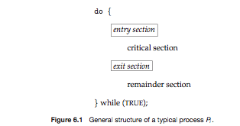
Critical Section
  Critical section is a code segment that contains shared variables that's why it need to be synchronized to maintain consistency of data variables. Critical Section can be accessed by only one process at a time.

Slide 8
Critical Section
  Entry Section It is part of the process, which decide the entry of a particular process in the Critical Section, out of many other processes.
  Critical Section - It is the part in which only one process is allowed to enter and modify the shared variable. This part of the process ensures that only no other process can access the resource of shared data.
  Exit Section - This process allows the other process that are waiting in the Entry Section, to enter into the Critical Sections. It checks that a process that after a process has finished execution in Critical Section can be removed through this Exit Section.
  Remainder Section The other parts of the Code other than Entry - Section, Critical Section and Exit Section are known as Remainder Section.

Slide 9
Critical-Section Problem
Each process has a section of code, called the critical section, in which the process access and manipulate shared variables and files.
A race condition is a situation that may occur inside a critical section.
The problem is to ensure that when one process is executing in its critical section then no other process can execute their critical section
Race conditions in critical sections can be avoided if the critical section is treated as an atomic instruction.
This can be done by process synchronization.

Slide 10
Solution to Critical-Section Problem
1. Mutual Exclusion - If process P_{i} is executing in its critical section, then no other processes can be executing in their critical sections
2. Progress - If no process is executing in its critical section and there exist some processes that wish to enter their critical section, then the selection of the processes that will enter the critical section next cannot be postponed indefinitely
3. Bounded Waiting - A bound must exist on the number of times that other processes are allowed to enter their critical sections after a process has made a request to enter its critical section and before that request is granted.

Slide 11
1. Lock Variable Synchronization Mechanism
Its a software mechanism implemented in user mode, i.e. no support required from the Operating System.
Its a busy waiting solution.
It can be used for more than two processes.
            do {
              acquire Lock
                CRITICAL SECTION
              release Lock
              Remainder Section
            } while(TRUE)

Slide 12
1. Lock Variable Synchronization Mechanism
while(lock != 0); // While (lock ==1);
Lock = 1;
  CRITICAL SECTION
Lock = 0;
Remainder Section
Mutual Exclusion
Progress
Bounded Waiting
?
Lock = 0
P
P

Slide 13
2. Test And Set Instruction
It requires the operating system support
It is a busy waiting solution.
It suffers from spin lock.
while(lock != 0); // While (lock ==1); Lock = 1; CRITICAL SECTION Lock = 0; Remainder Section | while(1) { while (TestAndSet(&lock)); critical section lock = false; remainder section } | boolean TestAndSet (*target) { boolean rv = *target; *target = true; return rv; }

Slide 14
2. Test And Set Instruction
It requires the operating system support
It is a busy waiting solution.
It suffers from spin lock.
while(1) { while (TestAndSet(&lock)); critical section lock = false; remainder section } | boolean TestAndSet (*target) { boolean rv = *target; *target = true; return rv; }
Mutual Exclusion
Progress
Bounded Waiting
?
Lock
target
rv
P
P

Slide 15
Synchronization Mechanism
The Lock Variable
Doesn't provide guarantee of mutual exclusion in some cases.
Test And Set Instruction
May cause starvation that means it can not ensure bounded waiting.

Slide 16
3. Turn Variable or Strict Alternation
• Its a software mechanism implemented in user mode, i.e. no support required from the Operating System.
• Its a busy waiting solution
• Turn Variable or Strict Alternation Approach is valid for only two processes.
P
P
while (turn!= 0); Critical Section turn = 1; Non - CS | while (turn!= 1); Critical Section turn = 0; Non – CS
Mutual Exclusion
Progress
Bounded Waiting
?

Slide 17
Synchronization Mechanism
The Lock Variable
Doesn't provide guarantee of mutual exclusion in some cases.
Test And Set Instruction
May cause starvation that means it can not ensure bounded waiting.
Turn Variable & Strict Alternation
Progress is not guaranteed.

Slide 18
4. Interested Variable
It uses an interest variable to provide the synchronization where interested variable is extra Boolean variable
This solution is valid for only two processes.
It is architectural neutral since it does not require any support from the operating system.
It is a busy waiting solution
Interested_Variable [i] = T ; while (Interested_Variable [j] ==T); Critical Section Interested_Variable [i] = F; Remainder Section

Slide 19
4. Interested Variable
P
P
Interested_Variable [i] = T ; while (Interested_Variable [j] ==T); Critical Section Interested_Variable [i] = F; Remainder Section
Interested_Variable [i] = T ; while (Interested_Variable [j] ==T); Critical Section Interested_Variable [i] = F; Remainder Section
P
P
Interested_Variable
Mutual Exclusion
Progress
Bounded Waiting
?

Slide 20
Synchronization Mechanism
The Lock Variable
Doesn't provide guarantee of mutual exclusion in some cases.
Test And Set Instruction
May cause starvation that means it can not ensure bounded waiting.
Turn Variable & Strict Alternation
Progress is not guaranteed.
Interested Variable
It can suffers from deadlock.

Slide 21
5. Peterson’s Solution
Peterson's Solution is a classical software based solution to the critical section problem.
It does not require any special hardware
This solution is valid for only two processes.
Its a busy waiting solution
do { flag[i] = TRUE; turn = j; while (flag[j ]== true && turn == j); critical section flag[i] = FALSE; remainder section } while (TRUE);
P
P
flag

Slide 22
5. Peterson’s Solution
P
P
do { flag[0] = TRUE; turn = 1; while (flag[1]== true && turn== 1); critical section flag[0] = FALSE; remainder section } while (TRUE);
do { flag[1] = TRUE; turn = 0; while (flag[0]== true && turn== 0); critical section flag[1] = FALSE; remainder section } while (TRUE);
Mutual Exclusion
Progress
Bounded Waiting
?
P
P
flag

Slide 23
5. Peterson’s Solution
Mutual exclusion is preserved.
The progress requirement is satisfied.
The bounded-waiting requirement is met.
It doesn't work correctly on modern architectures.

Slide 24
6. Semaphores
A semaphore is an integer variable that, apart from initialization, is accessed only through two standard atomic operations: wait () and signal ().
The wait() operation is also termed as P and signal () is also termed as V
When one process modifies the semaphore value, no other process can simultaneously modify that same semaphore value.
wait()
down
P()
Signal()
up
V()

Slide 25
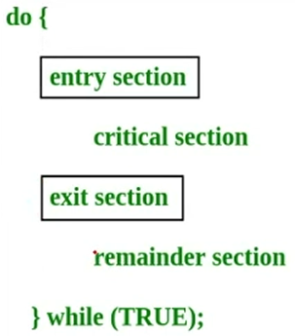
6. Semaphores
wait (S) { while (S <= 0); S--; }
signal (S) { S++; }

Slide 26
6.1 Binary Semaphores
1. The value of a binary semaphore can range only between 0 and 1. On some systems, binary semaphores are known as mutex locks, as they are locks that provide mutual exclusion.
2. Binary semaphores can be used to solve the critical-section problem for multiple processes.
3. Semaphore requires Busy Waiting.
4. Definition of the wait () and signal () semaphore operations, are modified to solve busy waiting problem
5. Instead of busy waiting, the process are blocked and placed into a waiting queue associated with semaphore by sleep() operation.
6. Blocked process can be restarted a wakeup () operation, when some other process executes a signal() operation. It changes process state from the waiting state to the ready state.

Slide 27
6. Binary Semaphores
P(semaphore s) { if (s.value == 1) s.value = 0; else { // add the process to the waiting queue q.add(P); sleep(); }}
V(semaphore s) { if (s.q isEmpty() ) s.value = 1; else { // select a process from waiting queue Process p = q.remove(); wakeup(); }}
Mutual Exclusion
Progress
Bounded Waiting
?
S
1
P
P
P
P
P
P
Q

Slide 28
Reference: Chapter 6

Slide 29
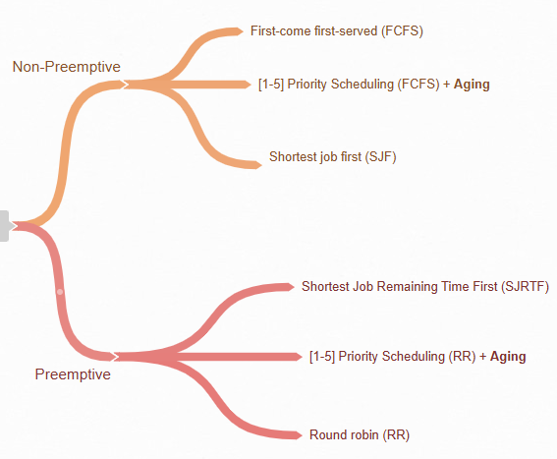
Assignment 3.1*: High-Weight Contribution to Final Grade
Run each algorithm 10 times, resetting the ready queue and generating random processes before each run.
Requirements:
1. Ready Queue: List of 15 processes with random names [A-Z], arrival times [1-50], burst times [1-100], and priorities [1-5].
2. Gantt Chart: Timeline (length 100) showing which process ran each quantum; use `#` for idle times.
3. Statistics: Calculate average TAT, WT, RT, throughput, and list processes that never ran.
4. Report: Present comparative analysis in LaTeX (Overleaf) or MS Word.
Note: Plagiarism is strictly prohibited.

